Slide 1
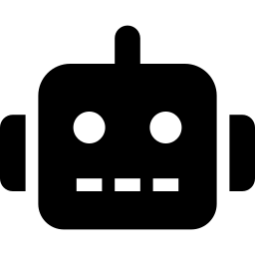
AI AGENTS EXPLAINED
Understanding, Designing, and Building Modern AI Agents
Smitha Kolan
Senior AI Engineer, Google
Key focus: From theory to practice using Google's Agent Development Kit (ADK)

Slide 2


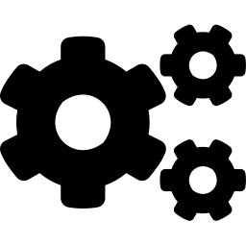

What Is an AI Agent?
Software that doesn't just answer — it decides and takes action.
TRADITIONAL CHATBOT
Input
Model
Output
Single response — no memory, no action.
AI AGENT
CORE CAPABILITY
Agents break down complex requests into steps and execute them autonomously.
Input
Decider
Action
(API/Code/DB)
Result
Feedback loop

Slide 3



The Theoretical Foundation: ReAct
Based on the research paper "ReAct: Synergizing Reasoning and Acting in Language Models"
AUTONOMY
Reason
Act
THE LOOP
Agents use reasoning, planning, and memory to act on behalf of the user.
Internal thinking
Calling a tool or API
Each cycle refines the agent's approach until the goal is achieved.
Adjust / Decide
Observe
Loop back to reasoning
Analyzing data results

Slide 4
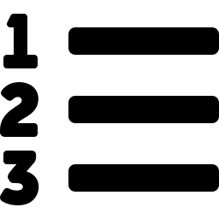

Three Agent Behavior Patterns
1
2
3
Sequential Agents
Reactive Agents
Deliberate / Planning Agents
Assembly line
Real-time decision-maker
Travel agent
Step-by-step, predictable, but rigid.
Decides in the moment, flexible, but lacks long-term planning.
Pauses to sketch a multi-step plan before execution; manages dependencies.

Slide 5



Building a Blog-Writing Agent
Objective: create a multi-agent system that writes a technical blog post from a single topic.
The Conductor
Root Agent — delegates tasks to tools
The Planner
Loop Agent — generates a structured outline
The Writer
Loop Agent — drafts the full post based on the outline
Tooling: Google's Agent Development Kit (ADK) and the Gemini-Flash-Latest model

Slide 6



Environment Setup
STEP 1
Package Management
Install uv for fast Python environment management.
STEP 2
Library
Install google-adk.
STEP 3
Configuration
Create agent.py, import key libraries (Agent, LoopAgent, agent_tool), and load environment variables for the model.

Slide 7
The Planner & Validation Loop
Yes
The Planner Sub-Agent
Instructed as a "technical content strategist" to produce Markdown outlines.
Valid
outline?
Respond "Okay."
No
Respond "Retry" + list missing pieces
The Checker Sub-Agent
A "quality gate" that reviews the outline.
Robustness: Wrapped in a LoopAgent that retries the process (up to 3 times) if validation fails.

Slide 8

The Blog Writer Agent
Role: transforms the validated outline into a full-length article.
Target Audience
Focus
Software engineers
Practical insights and the “how and why”
Format
Memory
Markdown with code snippets and proper H2/H3 headings
Pulls the outline from the shared state created by the Planner

Slide 9

Orchestration — The Root Agent
The Blogger (Root Agent): the primary point of contact for the user.
1
2
3
4
Receive topic
from user
Call Planner Tool
(Reasoning/Planning)
Call Writer Tool
(Action/Drafting)
Finalize titles +
social hooks
Key Concept: Tools allow the Root Agent to call complex sub-agents as if they were simple functions.
Fits into the larger system: Conductor → Planner → Writer → Root Agent finalizes output.

Slide 10
Running and Testing (ADK Web)
adk web
Launches a local web-based UI (Agent Development Kit)
Trace
Watch the “thinking” process of sub-agents.
State
Monitor the shared data between agents.
Interaction
Chat directly with the Root Agent to kick off workflows.

Slide 11
Summary & Next Steps
Agents are defined by their ability to reason and act.
Modular design (sub-agents + checkers) ensures high-quality output.
Google ADK simplifies the development of these complex loops.
NEXT LEVEL
Connecting agents to real-world servers using MCP (Model Context Protocol).

